Slide 1
The Best Thing Since Sliced Breadboards
Getting started in ourc

Slide 2
Ohm’s law
V = IR

Slide 3
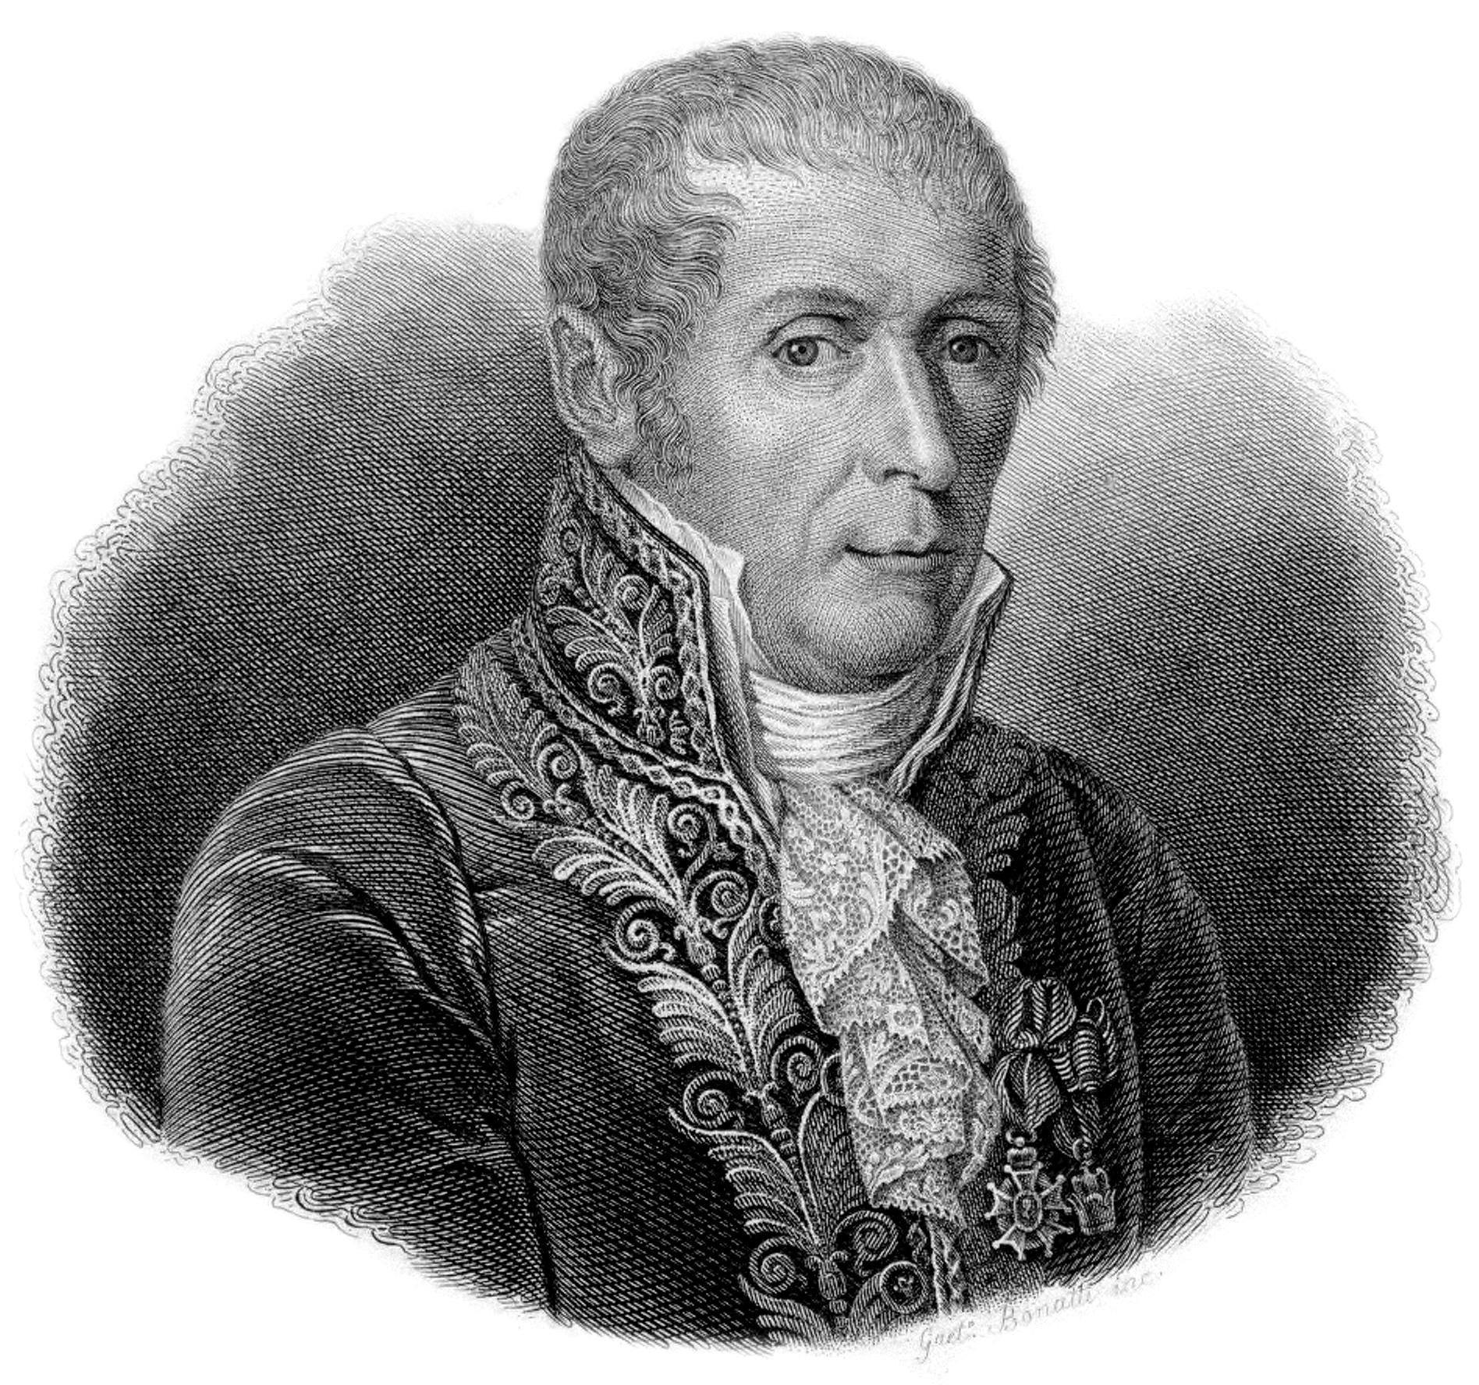
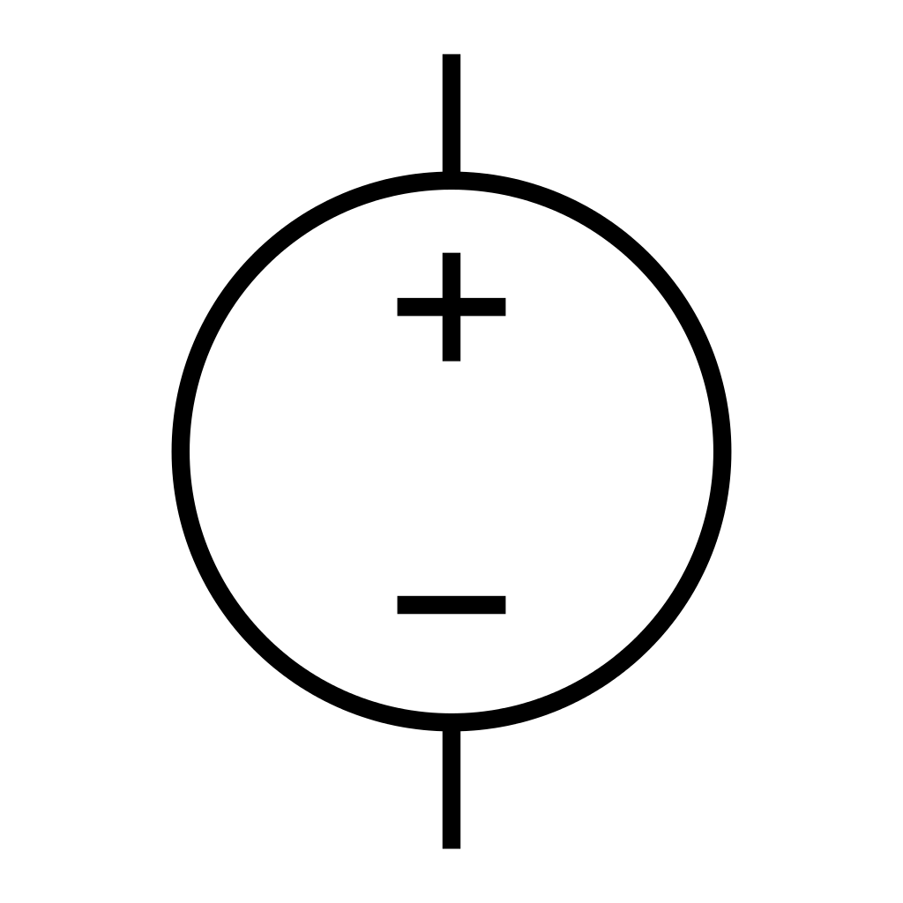
Voltage
Voltage is difference in electric potential
Units: Volts, V
Named for Alessandro Volta
Notes:
Equal to the work done per unit charge against a static electric field to move a charge between two points

Slide 4

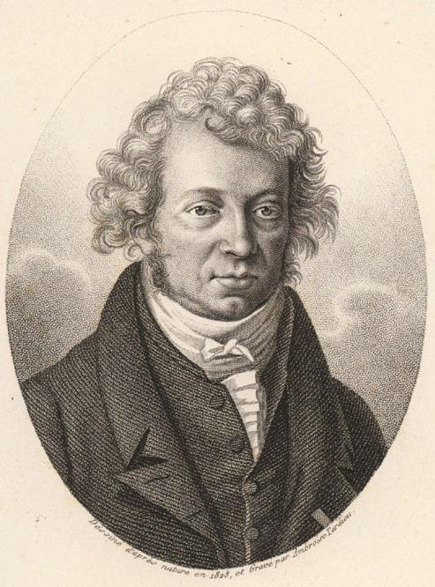
current
Amount of charge flowing per unit time
Flow of electrons
Units: Amperes, A
Named for Andre Marie Ampere

Slide 5
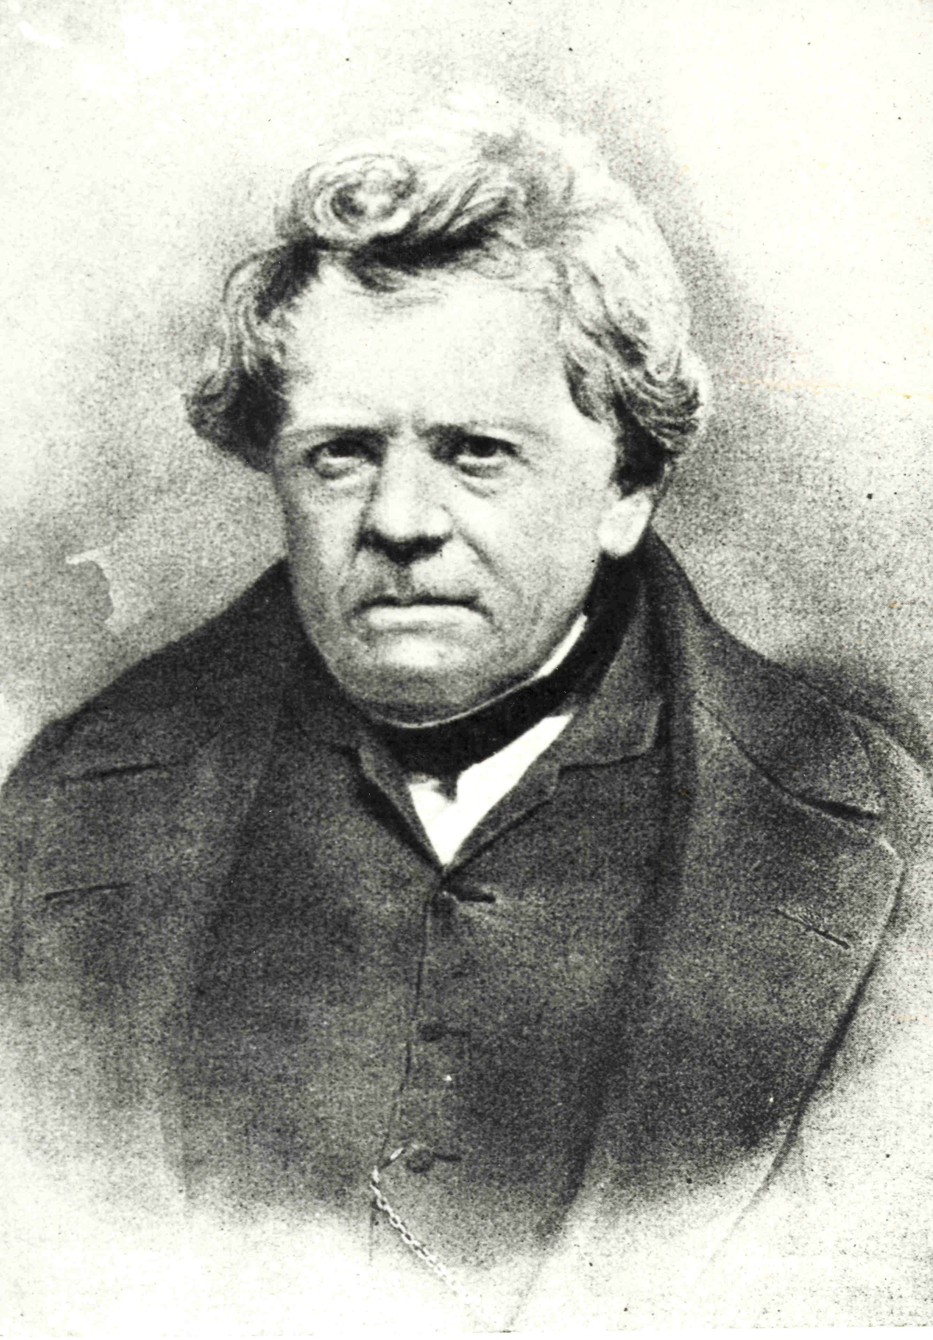

Resistance
Units: Ohm, Ω
Unit named for Georg Ohm
Limits flow of electrons
Notes:
One Ohm defined as the resistance through a conductor where applying one volt will push one ampere

Slide 6
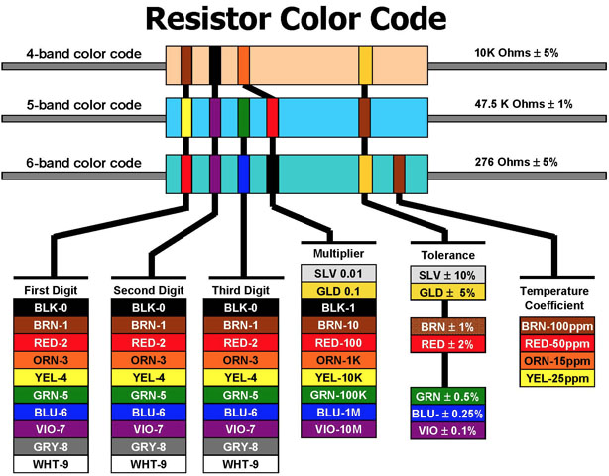

Slide 7
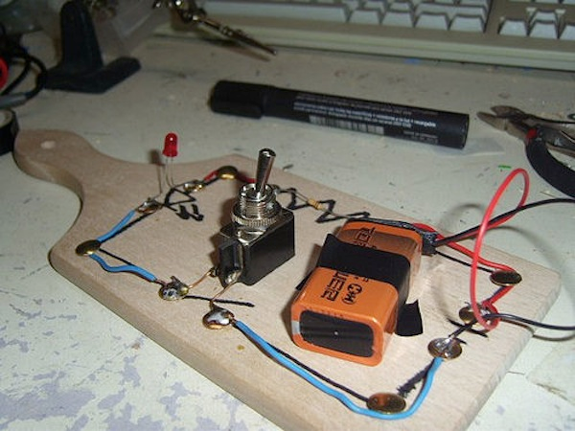
breadboards
Using solderless breadboards
Good for prototyping
Good for learning
Good for you
Why the name?
How do they work?
www.sparkfun.com

Slide 8
Logic
Three basic operations
AND
OR
NOT
After that,
NAND
NOR
XOR
XNOR

Slide 9

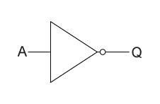
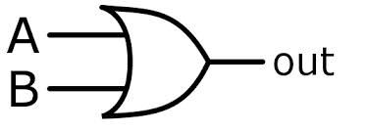
GATES
AND
OR
NOT

Slide 10
datasheets
Very useful for figuring out how an IC works
Examples as follows…

Slide 11
Task #1 - Beginner
Subtask 1
Light an LED
(HINT: Use a battery, a resistor, and an LED)
Subtask 2
Light an LED using a button
(HINT: exactly the same materials, just with a button)

Slide 12
Task #2 - INTERMEDIATE
Build a majority gate
Three inputs, one output
If a majority of the inputs are low, the output is low and vice versa
We have the truth table if you get stuck

Slide 13
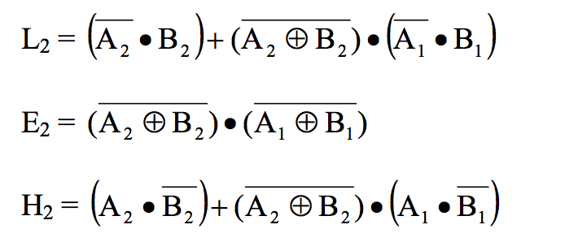
Task #3 – Slightly Advanced
Build a 2-bit binary comparator
Tests to see if two inputs are higher (numerically) than the other two inputs
We’ve got the truth table for this too, and will provide the equations!

